Slide 1
Health Care in Developing Countries:
Challenges and Opportunities
1. Dr. Paras K. Pokharel
Associate Professor of Community Medicine
BP Koirala Institute of Health Sciences, Dharan, Nepal
2. Prof. JN Pande, HoD, Medicine
3. Prof. LM Nath, Former Director,
Professor & Head, Centre for Community Medicine
All India Institute of Medical Sciences, New Delhi

Slide 2
The challenge of caring for a billion
India is the second most populous country in the world
The death rate has declined but birth rates continue to be high in most of the states.
Health care structure in the country is over-burdened by increasing population
Family planning programs need to be (re)activated

Slide 3
Challenge: Burden of Disease in the new millenium
India faces the twin epidemic of continuing/emerging infectious diseases as well as chronic degenerative diseases.
The former is related to poor implementation of the public health programs, and the latter to demographic transition with increase in life expectancy.

Slide 4
Economic development, Education and Health
Economic deprivation in a large segment of population results in poor access to health care.
Poor educational status leads to non-utilization of scanty health services and increase in avoidable risk factors.
Both are closely related to life expectancy and IMR.
Advances in medicine are responsible for no more than half of the observed improvement in health indices.

Slide 5
Human Development Indicators: A challenge for all
Longevity, literacy and GDP per capita are the main indicators of human development
Longevity is a measure of state of health, and is linked to income and education
Weakness in health sector has an adverse effect on longevity
India ranks low (115th) amongst world nations judged by HDI

Slide 6
High Burden of Disease
India faces high burden of disease because of lack of environmental sanitation and safe drinking water, under-nutrition, poor living conditions, and limited access to preventive and curative health services
Lack of education, gender inequality and explosive growth of population contribute to increasing burden of disease
Full impact of the HIV epidemic and tobacco related diseases is yet to be felt

Slide 7
Health Care in India
Expenditure on health by the Government continues to be low. It is not viewed as an investment but rather as a dead loss!
States under financial constraints cut expenditure on health
Growth in national income by itself is not enough, if the benefits do not manifest themselves in the form of more food, better access to health and education: Amartyo K Sen

Slide 8
Human health has probably improved more over the past half century then over the previous three millennia. This is a stunning achievement - never to be repeated and, it is to be hoped, irreversible. Despite the devastating impact that HIV/AIDS is having in Africa and will increasingly have in south east Asia, it is likely that, overall, human health will continue to improve steadily during the coming decades. contd

Slide 9
Inequity in Health Care
A dark cloud, however, threatens to blot out the sun from this landscape. Almost everywhere, the poor suffer poor health and the very poor suffer appallingly.
In addition the gap in health between rich and poor remains very wide. Addressing this problem, both between countries and within countries, constitutes one of the greatest challenges of the new century. Failure to do so properly will have dire consequences for the global economy, for social order and justice, and for the civilization as a whole.
Notes:
Feachem RGA (Editor, Bulletin WHO)
Jan, 2000

Slide 10
Deaths by age groups in developed and developing world
14
12
10
Deaths in
8
millions
6
4
2
0
0-4
5--14
15-29
30-44
45-59
60-69
>70
Age group in years
Developed
Developing

Slide 11
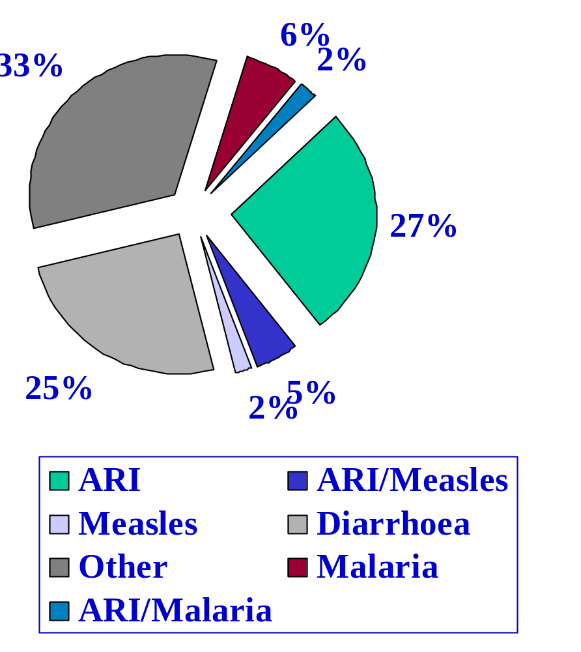
Distribution of 12 million deaths in under 5 in developing countries, 1993
~10% disease burden could be avoided by access to safe water
~20% disease burden could be avoided by eliminating malnutrition

Slide 12
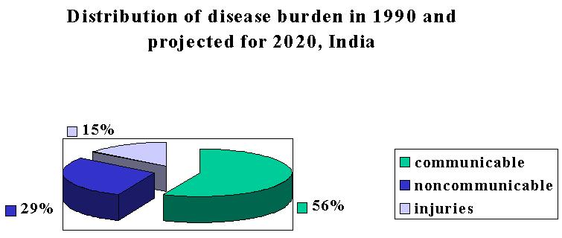
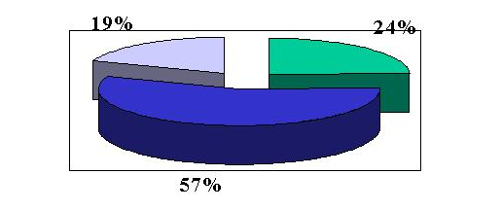
1990
2020

Slide 13
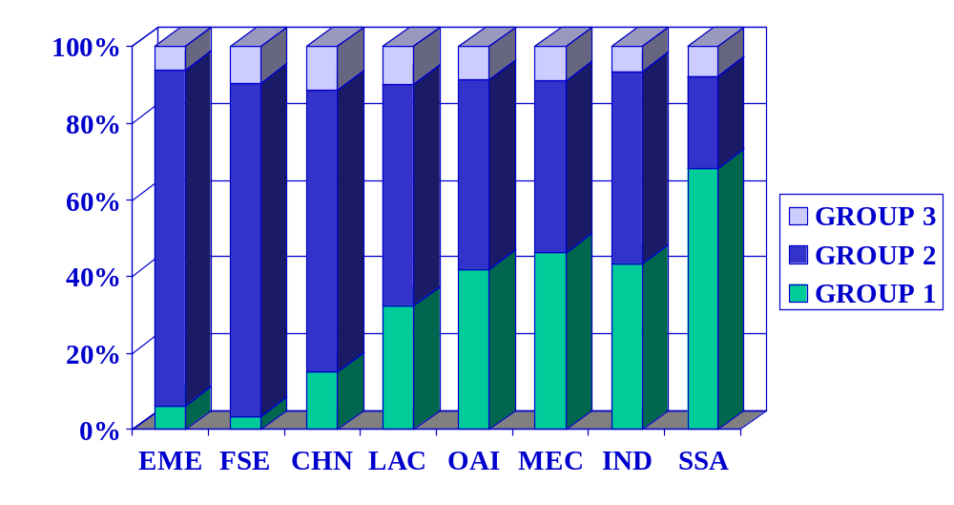
Distribution of deaths from three groups of causes, by region: 1990
Murray and Lopez, 1994

Slide 14
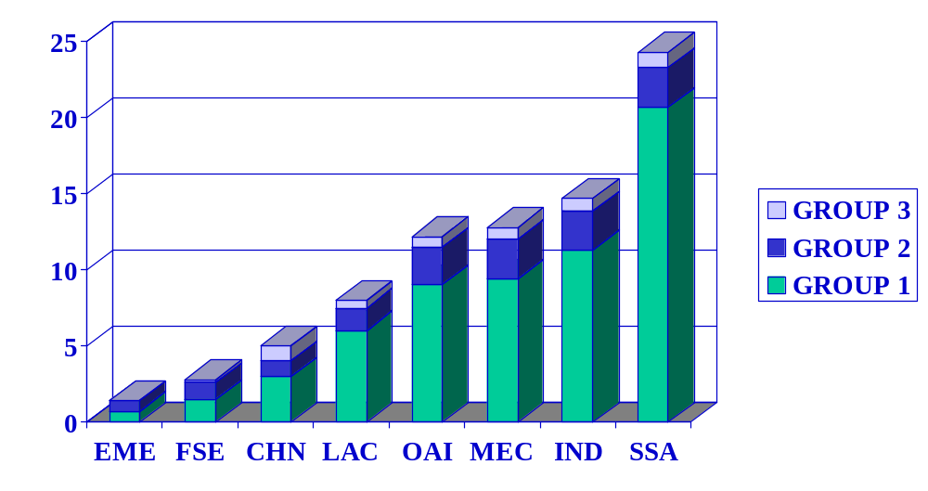
Probability of death in males 0-14 years from three groups of causes
Murray and Lopez, 1994

Slide 15
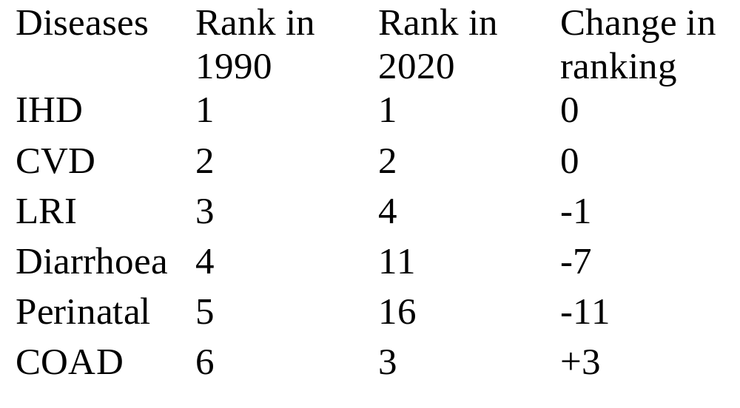
Top causes of death in 1990 and 2020

Slide 16
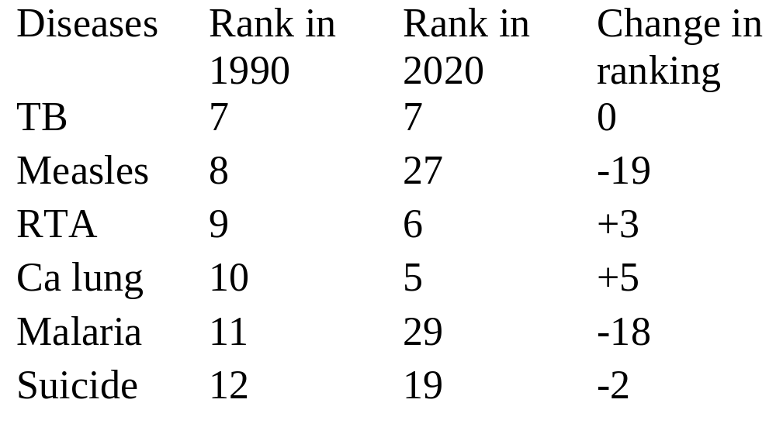
Top causes of death in 1990 and 2020

Slide 17
Health Care in India
India has 48 doctors per 100,000 persons which is fewer than in developed nations
Wide urban-rural gap in the availability of medical services: Inequity
Poor facilities even in large Government institutions compared to corporate hospitals (Lack of funds, poor management, political and bureaucratic interference, lack of leadership in medical community)

Slide 18
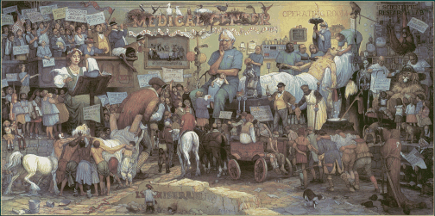
A day in hospital:

Slide 19
Health Care in India:
Curative Health Services
Increasing cost of curative medical services
High tech curative services not free even in government hospitals
Limited health benefits to employees
Health insurance expensive
Curative health services not accessible to rural populations

Slide 20
Health Care in India
Private practitioners and hospitals major providers of health care in India
Practitioners of alternate systems of medicine also play a major role
Concerns regarding ethics, medical negligence, commercialization of medicine, and incompetence
Increasing cost of medical care and threat to healthy doctor patient relationship

Slide 21

There is a marked shortage of trained nurses

Slide 22
Health Care in India
Prevention, and early diagnosis and treatment, if feasible, are the most cost-effective strategies for most diseases
Promoting healthy life style from early life is a ‘no cost’ intervention which needs to be incorporated in school curricula. There is need for increasing public awareness of the benefits of healthy life style

Slide 23
Components of healthy life style
Abstinence from tobacco use
Regular physical exercise
Balanced nutritious diet rich in vegetables and fruits, and low in fats and refined sugar
Avoidance of pre and extramarital sex
Yoga and meditation
Avoidance of alcohol and substance abuse

Slide 24
Physical activity and Health Report of the Surgeon General, 1996
All people benefit from regular physical activity
Moderate physical activity for 30-45 minutes on all days of the week is required
Additional benefits can be gained from more strenuous activity for longer periods
Physical activity reduces the risk of premature death, CAD, hypertension, diabetes and colon cancer. It also improves mental health.
A large number of adults including youths are not regularly physically active
Certain interventions to promote physical activity in schools, work site and health care settings have been found to be beneficial

Slide 25
Interventions with a large potential impact on health outcomes
Immunization (EPI plus)
DOTs for tuberculosis
Maternal health and safe motherhood interventions
Family planning
School health interventions
HIV/AIDS prevention
Integrated management of childhood illnesses
Treatment of STD
Malaria control
Tobacco control

Slide 26


Slide 27
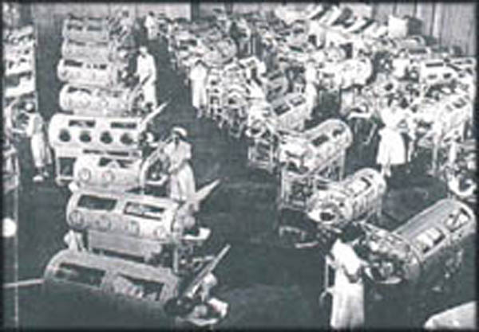
Polio may soon be eradicated from India and the globe

Slide 28
Available vaccines against some human pathogens
Whooping cough
Tetanus
Diphtheria
Polio
Measles, rubella
Cholera
Tuberculosis ?
S typhi
N meningitidis C
Smallpox
Anthrax
Strep pneumoniae
H influenzae
Hepatitis A and B
Jap encephalitis
Mumps
Rabies
Yellow fever
Varicella-zoster
Influenza A

Slide 29
Vaccines undergoing phase 3 clinical trials*
Leprosy
Leishmania
S typhi
N meningitidis B
Influenza B
Rotavirus
* expected to be available in 5-10 years

Slide 30
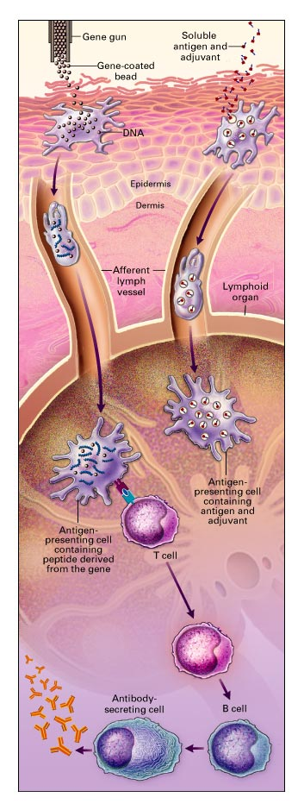
Vaccination coverage in India continues to be low, and falls short of the target of 90%. Recommended vaccinations under EPI include DPT, polio, BCG, measles. It is proposed to add Hepatitis B and H influenzae type b to this list.
Measles continues to cause 30% of all vaccine preventable deaths, mostly in developing countries.
Challenge is to increase the immunization coverage to the desired level.
Also to develop newer vaccines and new modes of delivery.

Slide 31
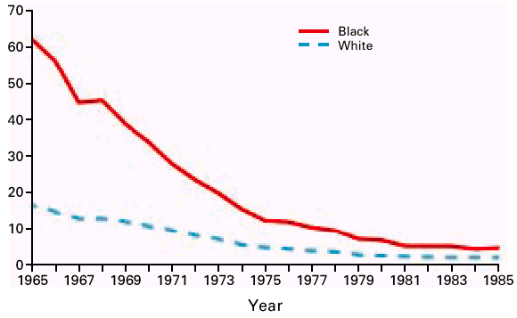
Number of deaths from pneumonia
per 100,000 children <15 years in US
Vaccination is not the only
answer!

Slide 32
Rational use of diagnostic tests
Inappropriate and irrational use of high tech and expensive diagnostic tests is widely prevalent in developing countries (CT, serology for TB)
Market forces, misinformation, desire to do something
Governmental regulation not feasible; improved diagnostic reasoning required

Slide 33
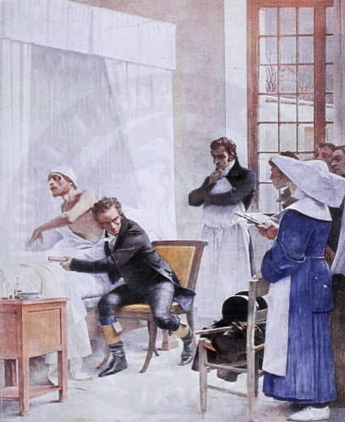
There has been an explosion of high tech diagnostic, therapeutic and preventive interventions in the field of medicine and surgery
This has resulted in physicians spending less time in history taking and physical examination.

Slide 34
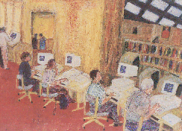

Slide 35
Rational Drug Use
Can prevent emergence of anti-microbial drug resistance, and reduce drug toxicity, adverse drug reactions, and the cost of treatment
Requires coordinated approach: Patient and physician education, antibiotic policy, hospital infection control team, regional and national antibiotic resistance surveillance

Slide 36

Emergence of antibiotic resistant bacteria
Cohen;Science 1992;257:1050

Slide 37
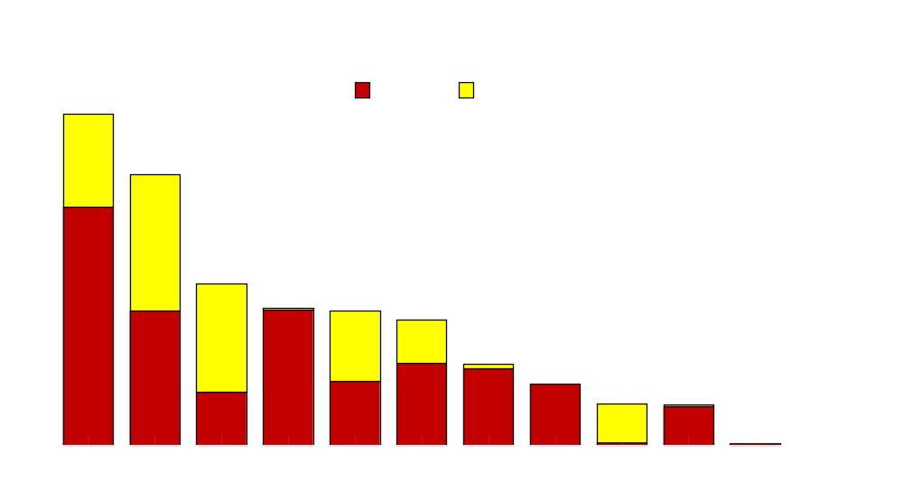
Pneumococcal Resistance Among
4,634 Invasive Isolates, U.S. 1995-6
Cetron;ASM 1997;abstract C-283

Slide 38
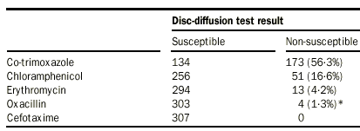
Drug susceptibility of Strep pneumoniae
IBIS Study

Slide 39
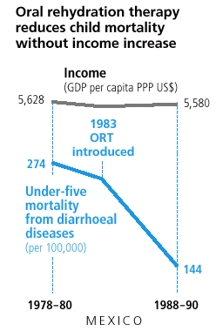
Low cost interventions have been successful in reducing morbidity and mortality from many diseases.
DOTs for treatment of tuberculosis is one such intervention.
Behavioral interventions for reducing transmission of HIV inefction, and management of STD and RTI are also cost-effective interventions.

Slide 40
Health Care in Developing Countries
Existing infrastructure for health care needs to be strengthened. Health should be perceived as an investment and receive greater budgetary allocation
Education, safe water and sanitation need priority
Vaccination coverage to be improved
Better implementation of national health programs
Judicious use of the scant resources by promoting most cost-effective strategies for disease prevention
Inclusion of all level of stakeholders in planning and policy making using tremendous human resource available in the country

